Slide 1

Agnel Charities’
Fr. C. Rodrigues Institute of Technology, Vashi, Navi-Mumbai
IoT BASED PATIENT HEALTH MONITORING SYSTEM
Group Number: 12
By
Diksha Bhosale-3021159
Pratik Belamkar-3021107
Mudabbir Ahmad-3021133
Varun Somwanshi-3021151
Under the Guidance of
Mrs. Akshata Raut
Department of Electronics and Telecommunication Engineering,
9 May 2025.

Slide 2
PRESENTATION OUTLINE
Problem Overview
Project Objectives
Advance Literature Survey
System Block Diagram/ Flow chart
Methodology
Implementation results
Conclusion
Reference

Slide 3
PROBLEM OVERVIEW
Delayed Intervention = High Risk Heart patients face life-threatening consequences due to delayed detection and response.
Unpredictable Health Deterioration-Chronic condition patients require continuous monitoring, as their health can worsen without warning.
Inadequate Access to Timely Care-Delays in healthcare delivery reduce survival chances and increase complications.
Lack of 24/7 Monitoring-Current systems often fail to provide round-the-clock observation, leaving gaps in care.
Need for Proactive and Immediate Response-Effective healthcare outcomes depend on real-time alerts and rapid medical action.

Slide 4
PROJECT OBJECTIVES
This system is an initiative of automation in critical health care management. It provides continuous monitoring of patient and allows automatic data transfer [2].
Important Parameters chosen which gives the detail small things which helps to examine Monitoring System , The data is uploaded on AWS and data is analysis

Slide 5
LITERATURE REVIEW
TITLE | AUTHOR | CONFERENCE/JOURNAL | LIMITATIONS
IoT-Based Low-cost Remote Patient Monitoring and Management system with Deep Learning-Based Arrhythmia and Pneumonia detection | Farhan Ishtiaque | 2021 IEEE 4th International Conference on Computing, Power and Communication Technologies (GUCON) University of Malaya, Kuala Lumpur, Malaysia. Sep 24-26, 2021 | It only has up to 94% of test accuracy .
Real Time Patient Activity Monitoring and Alert System | Aditya T R | Proceedings of the International Conference on Electronics and Sustainable Communication Systems (ICESC 2020) IEEE Xplore Part Number: CFP20V66-ART; ISBN: 978-1-7281-4108- | It does not monitor patient activity
Remote Patient Monitoring System Using Arduino | Amruta Unawane | IEEE SA: Setting the Standard for Future Remote Patient Monitoring and Telehealth Solutions | Healthcare institutions need to invest in user-friendly and intuitive RPM platforms

Slide 6
TITLE | AUTHOR | CONFERENCE/JOURNAL | LIMITATIONS
Smart System for Real-Time Remote Patient Monitoring Based on Internet of Things | Nasser Al M ziddi | Smart System for Real-Time Remote Patient Monitoring Based on Internet of Things | To detect abnormal signals , a doctor need to set Threshold values.

Slide 7
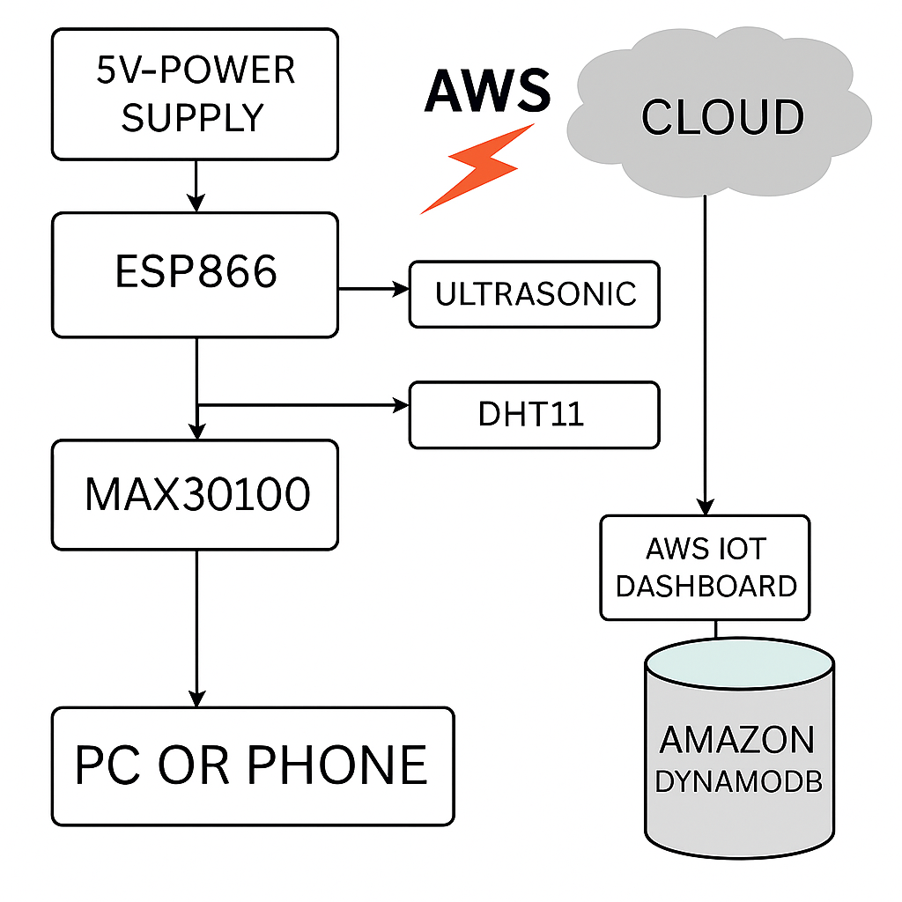
CIRCUIT DIAGRAM :
PC/MOBILE

Slide 8
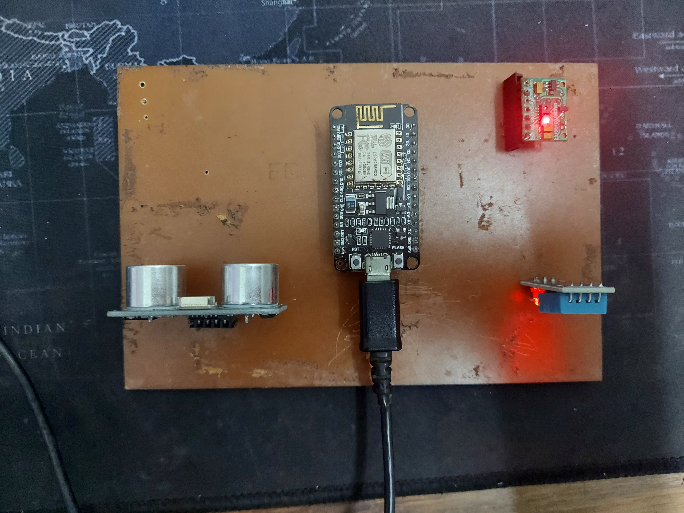
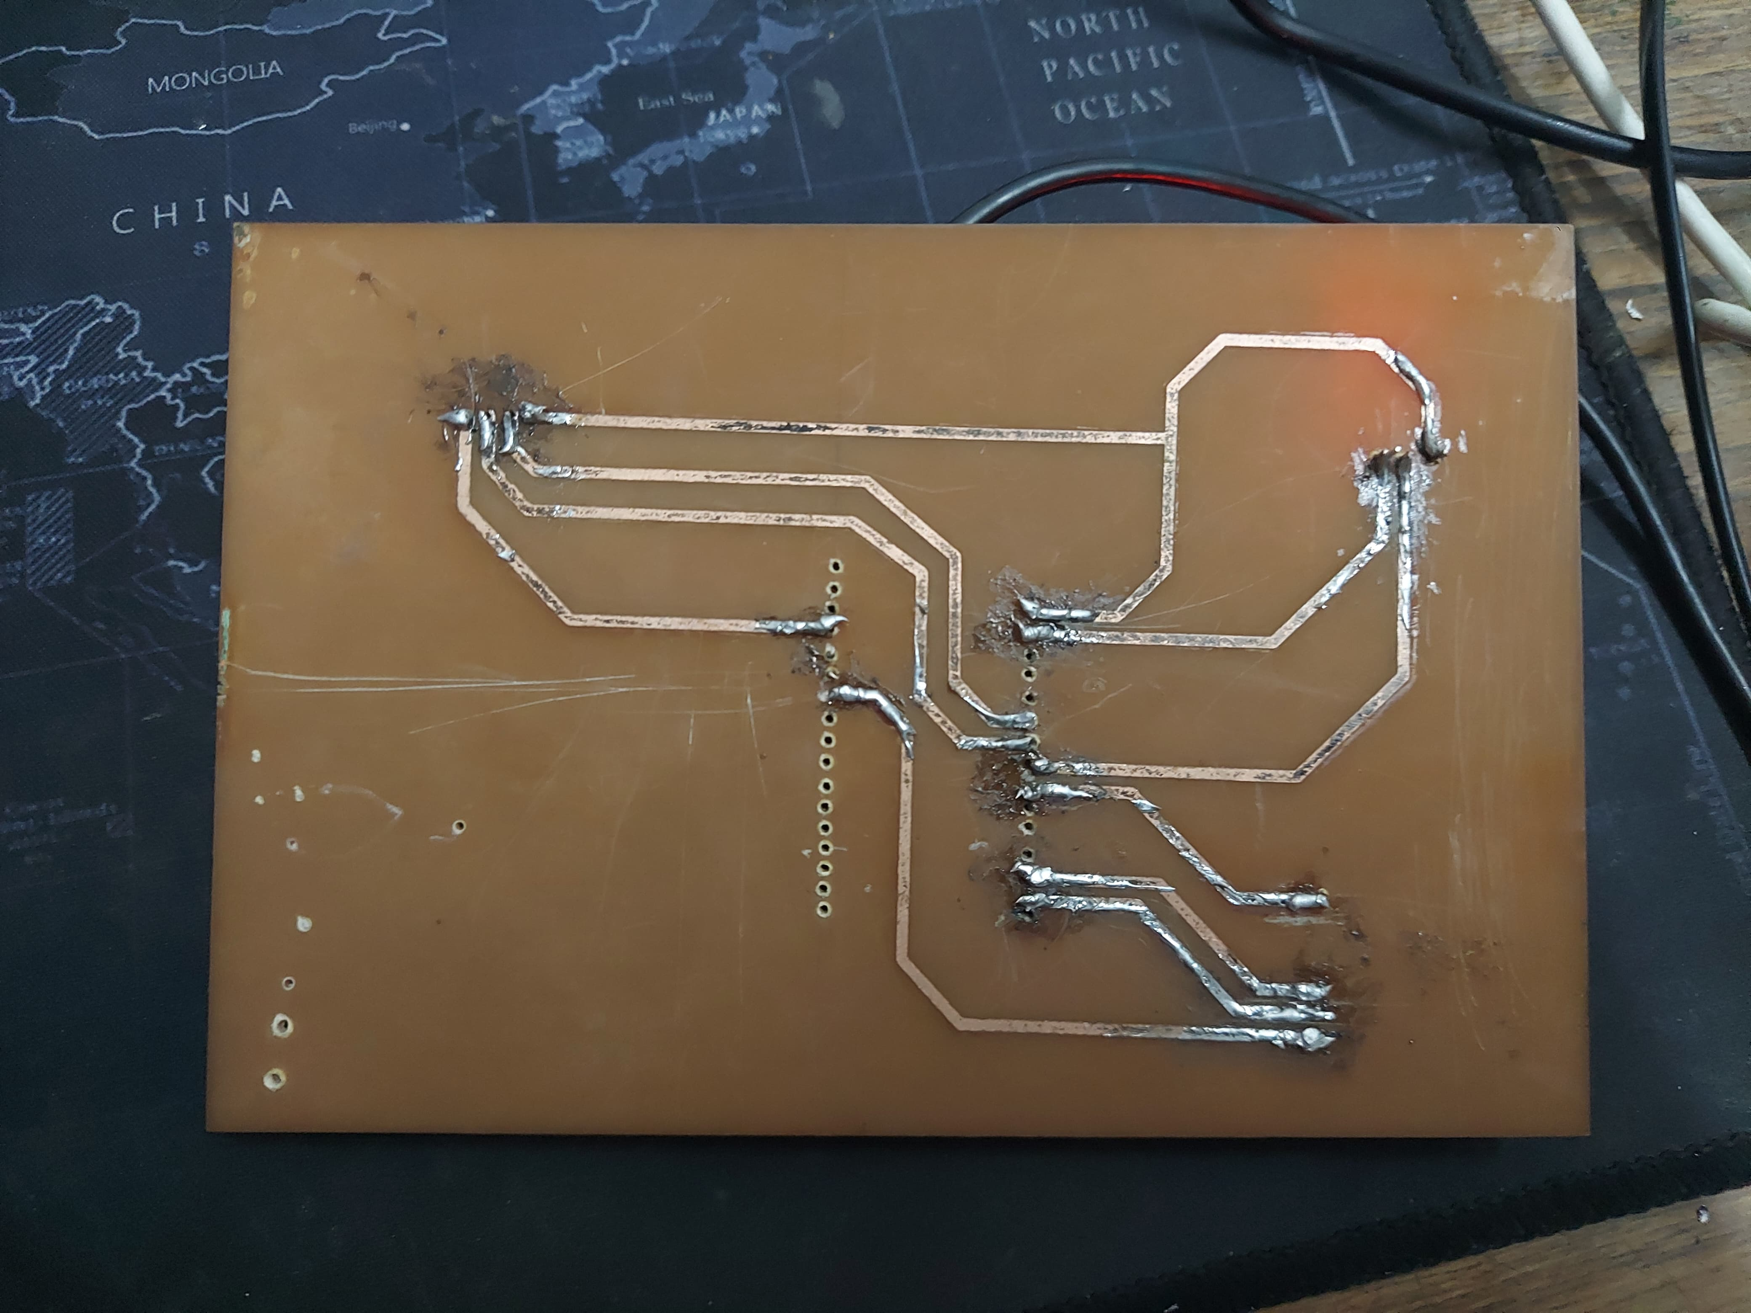
CUSTOM PCB

Slide 9
WORKING
Power Supply: 3.3V power ESP8266 and sensors
Sensors
MAX30100
DHT11
Ultrasonic Fluid Level
Processing: ESP8266 collects and processes sensor data.
Cloud Upload: Data sent to AWS IoT core via MQTT.
Alert System: AWS SNS sends email alert on critical readings.
Storage: Optional logging in DynamoDB

Slide 10
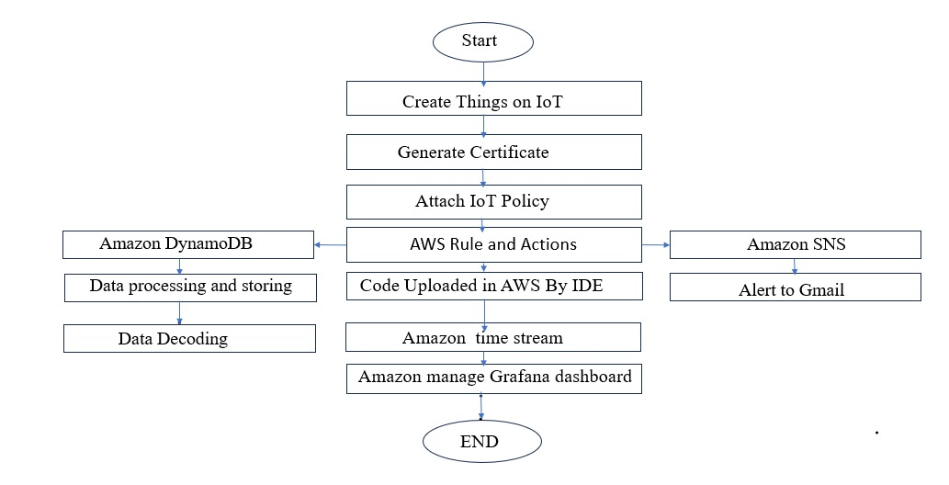
FLOWCHART OF DATA UPLOADING ON AWS
Start
Create Things on IoT
Generate Certificate
Attach IoT Policy
Install IoT libraries in Arduino IDE
Code Uploaded in AWS By IDE
Amazon time stream
Amazon manage Grafana dashboard

Slide 11
IoT System Setup Using AWS for Real-Time Monitoring
Create a Thing in AWS IoT Core – Represents the physical device in the cloud.
Generate a Certificate – Ensures secure authentication and connection.
Attach an IoT Policy – Defines permissions for secure communication.
Install IoT Libraries in Arduino IDE – Enables AWS connectivity via MQTT.
Upload Code to the IoT Device – Allows data transmission to AWS.
Store Data in Amazon Timestream – Efficiently manages real-time IoT data.
Visualize Data with Grafana Dashboard – Provides insights for monitoring and analysis.
Data Uploadation

Slide 12
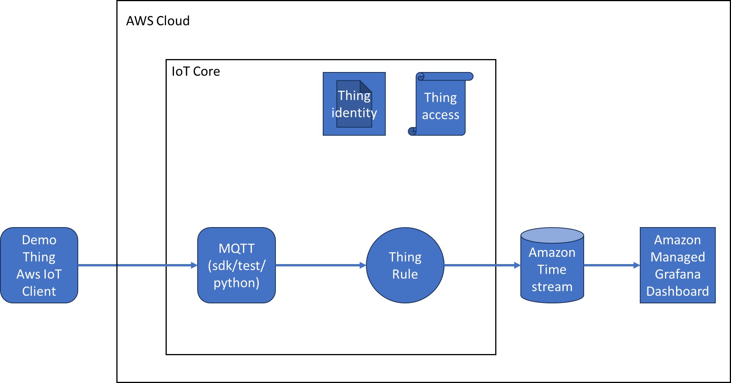
Architecture of Project:

Slide 13
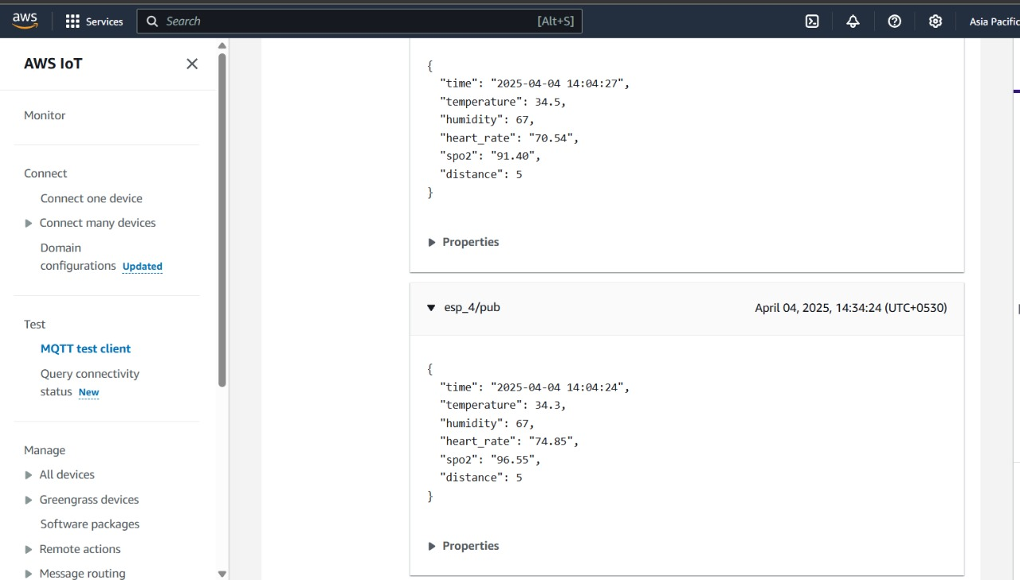
DATA SENT TO AWS

Slide 14
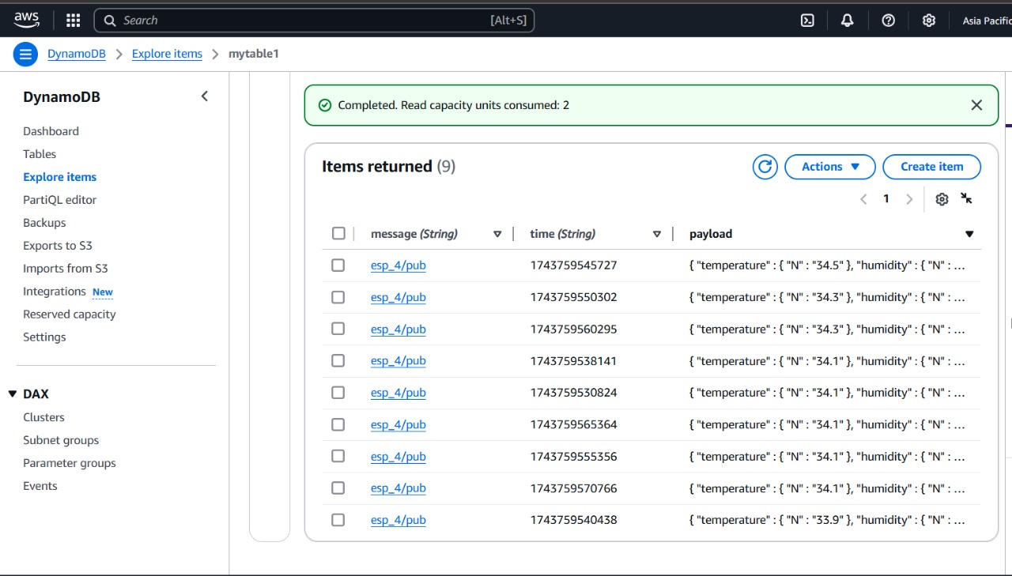
DYNAMO DB

Slide 15
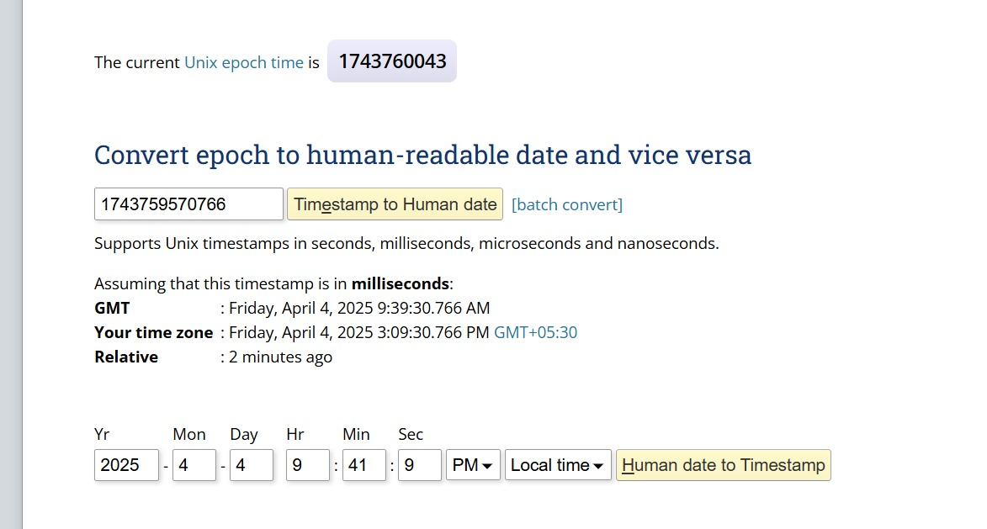
Epoch Time converter

Slide 16
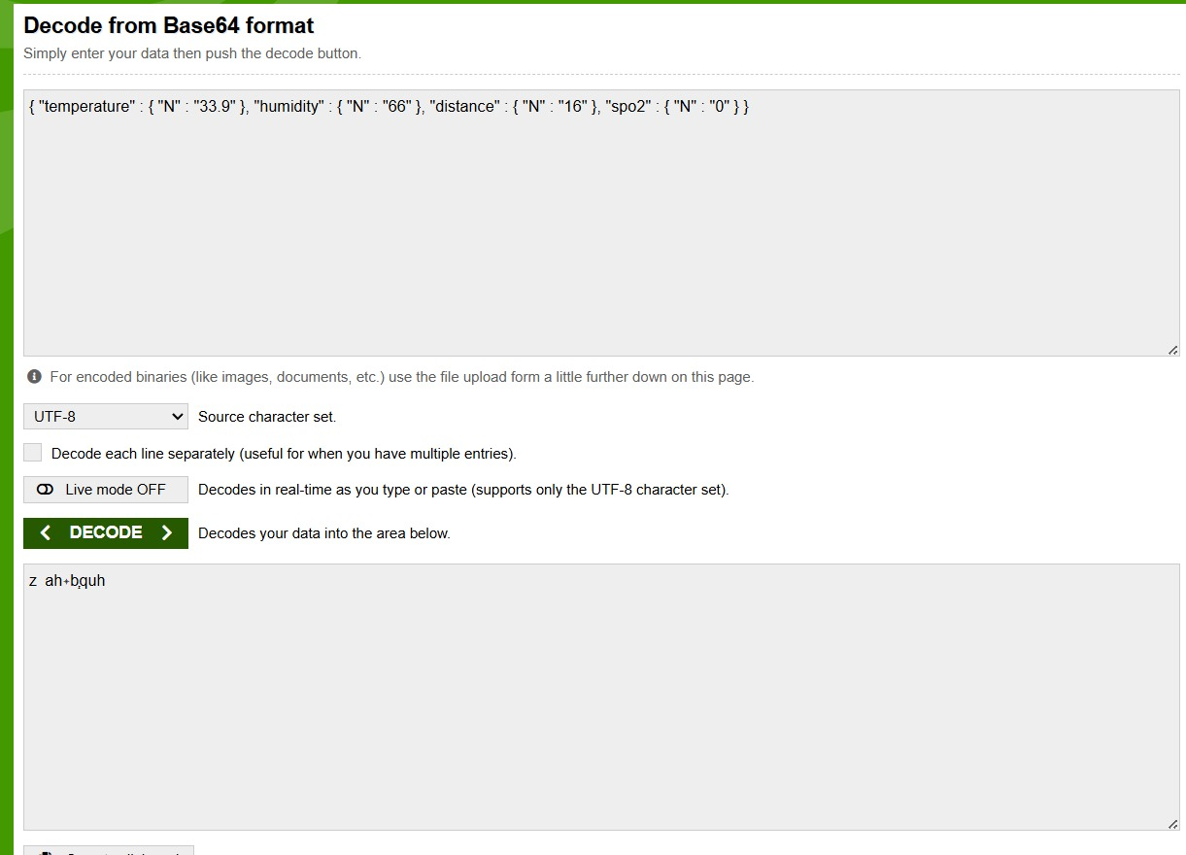
Base 64 Db decoder

Slide 17
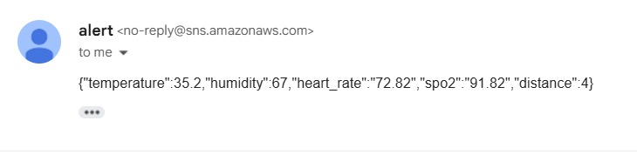
AWS Alert via email

Slide 18
SOFTWARE
AWS IoT Core -- Manages device communication using MQTT for secure data transfer.
AWS DynamoDB/S3 -- Stores incoming sensor data for real-time and historical analysis.
Arduino IDE --Provides a development environment to write, compile, and upload code to IoT hardware such as ESP32 and Arduino boards, enabling direct control and data acquisition from connected sensors

Slide 19
SUSTAINABLE DEVEOPMENT GOALS
IoT-based health care monitoring system aligns with the goal of ensuring healthy lives and promoting well-being for all ages by providing continuous health monitoring that can detect potential health issues early. It makes health data accessible to users, empowering them to manage their health proactively. This approach fosters a healthier lifestyle and improves overall well-being for individuals across different age groups.

Slide 20
[1] V.Ramya, B.Palaniappan, A Kumari, "Embedded Patient Monitoring System", International Journal of Embedded Systems and Applications, Vol.1, Issue 2, pp.51-63, 2011.
[2] M J Jayashree, A Sam Sunny, Anu John, "Smart Hospital Technology", An International Journal on Health Informatics, Vol.3, Issue 3, pp.9-16, 2014.
[3] Bharat Prajapati Jignesh Patel, "An Intelligent Real Time IoT Based System (IRTBS) for Monitoring ICU Patient ", " In International Conference on Information and Communication Technology for Intelligent Systems, pp. 390-396. Springer, Cham, 2017.
[4] H. T. Yew, M. F. Ng, S. Z. Ping, S. K. Chung, A. Chekima, and J. A. Dargham, “IoT Based Real-Time Remote Patient Monitoring System,” in Proceedings - 2020 16th IEEE International Colloquium on Signal Processing and its Applications, CSPA 2020, Feb. 2020, pp. 176–179, doi: 10.1109/CSPA48992.2020.9068699.
References

Slide 21
[6]A. I. Abboudi, A. I. Alhammadi, K. M. Albastaki, N. u. M. Khanum and A. Jarndal, "Design and Implementation of Portable Emergency Ventilator for COVID-19 Patients," 2022 Advances in Science and Engineering Technology International Conferences (ASET), Dubai, United Arab Emirates, 2022, pp. 1-4, doi: 10.1109/ASET53988.2022.9734315: {COVID-19;Temperature sensors;Temperature measurement;Ventilators;Pulse oximeter;Costs;Hospitals;Ventilator;COVID-19;Sensors;Resuscitator},
[7] H. T. Yew, M. F. Ng, S. Z. Ping, S. K. Chung, A. Chekima, and J. A. Dargham, “IoT Based Real-Time Remote Patient Monitoring System,” in Proceedings - 2020 16th IEEE International Colloquium on Signal Processing and its Applications, CSPA 2020, Feb. 2020, pp. 176–179, doi: 10.1109/CSPA48992.2020.9068699.
[8] N. Huda, S. Khan, R. Abid, S. B. Shuvo, M. M. Labib, and T. Hasan, “A low-cost, low-energy wearable ECG system with cloud-based arrhythmia detection,” medRxiv. medRxiv, Sep. 02, 2020, doi: 10.1101/2020.08.30.20184770.
[9] Kerechanin, C. W., Cytcgusm, P. N., Vincent, J. A., Smith, D. G., and Wenstrand, D. S., “Development of field portable ventilator systems for domestic and military emergency medical response,” John Hopkins Apl. Tech. Digest, 25(3), 2004.

Slide 22
[11] T. R. Aditya, S. S. Pai, K. Bhat U, P. Manjunath and G. Jagadamba, "Real Time Patient Activity Monitoring and Alert System," 2020 International Conference on Electronics and Sustainable Communication Systems (ICESC), Coimbatore, India, 2020, pp. 708-712, doi:10.1109/ICESC48915.2020.9155602.
[12] “MAX30100 Pulse Oximeter and Heart-Rate Sensor IC for Wearable ...”. [Online]. Available: https://www.maximintegrated.com/en/products/sensors/MAX30100.htm l. [Accessed: 17- Oct- 2021].
[13] Vasan, A., Weekes,R., Connacher W., Sieker J., Stambaugh, M., Suresh, P., ... & Acute Ventilation Rapid Response Taskforce (AVERT). (2020). MADVent: A low‐cost ventilator for patients with COVID‐19. Medical devices & sensors, 3(4), e10106.
[14] "An IoT based Patient Health Monitoring System": D Shiva RamaKrishna
https://ieeexplore.ieee.org/document/8899434
[15] "Development of IoT based Health Monitoring System for Disables using Microcontroller" : M Jyothi

Slide 23
[16]D. S. R. Krishnan, S. C. Gupta, and T. Choudhury, “An IoT based Patient Health Monitoring System,” in Proceedings on 2018 International Conference on Advances in Computing and Communication Engineering, ICACCE 2018, Aug. 2018, pp. 1–7

